Slide 1
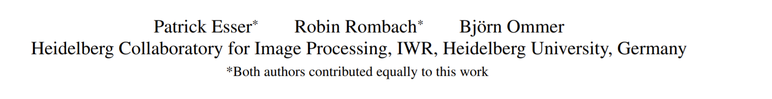
Taming Transformers for High-Resolution Image Synthesis
Wen Liu
2021/01/22
http://xxx.itp.ac.cn/pdf/2012.09841.pdf

Slide 2
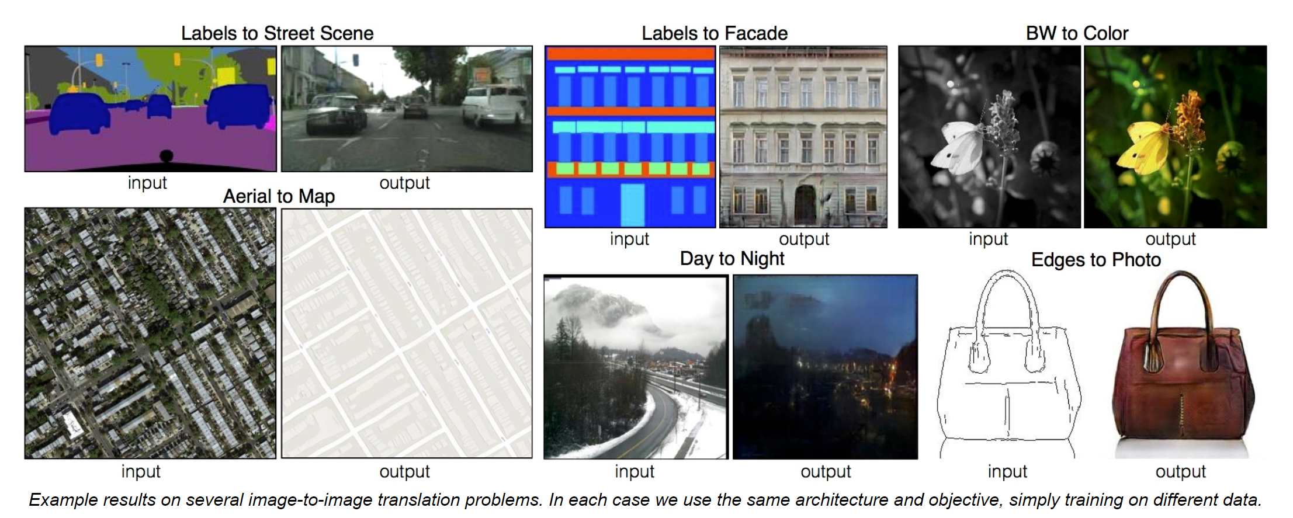
Conditional image-to-image generation
https://arxiv.org/pdf/1611.07004.pdf

Slide 3
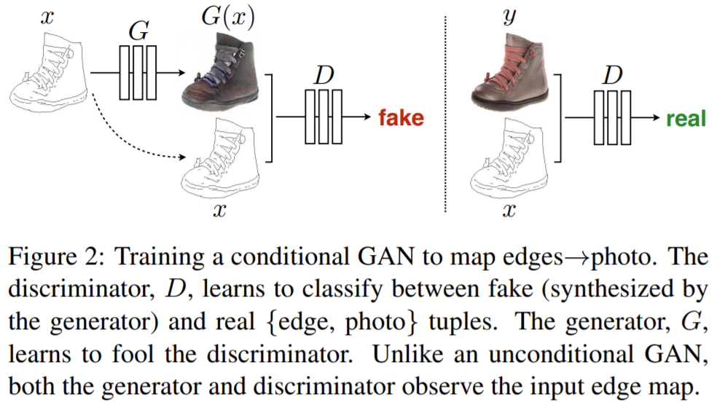
GAN-based Image Generation
https://arxiv.org/pdf/1611.07004.pdf

Slide 4
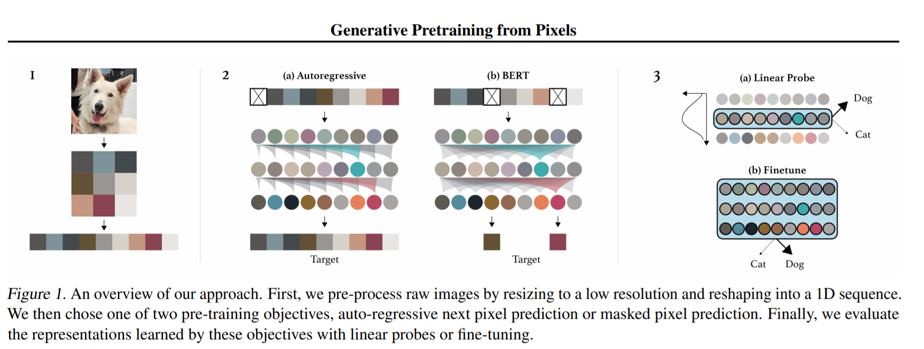
Transformer-based Image Generation
i-GPT
https://cdn.openai.com/papers/Generative_Pretraining_from_Pixels_V2.pdf

Slide 5
VQ-VAE-based Image Generation

Slide 6
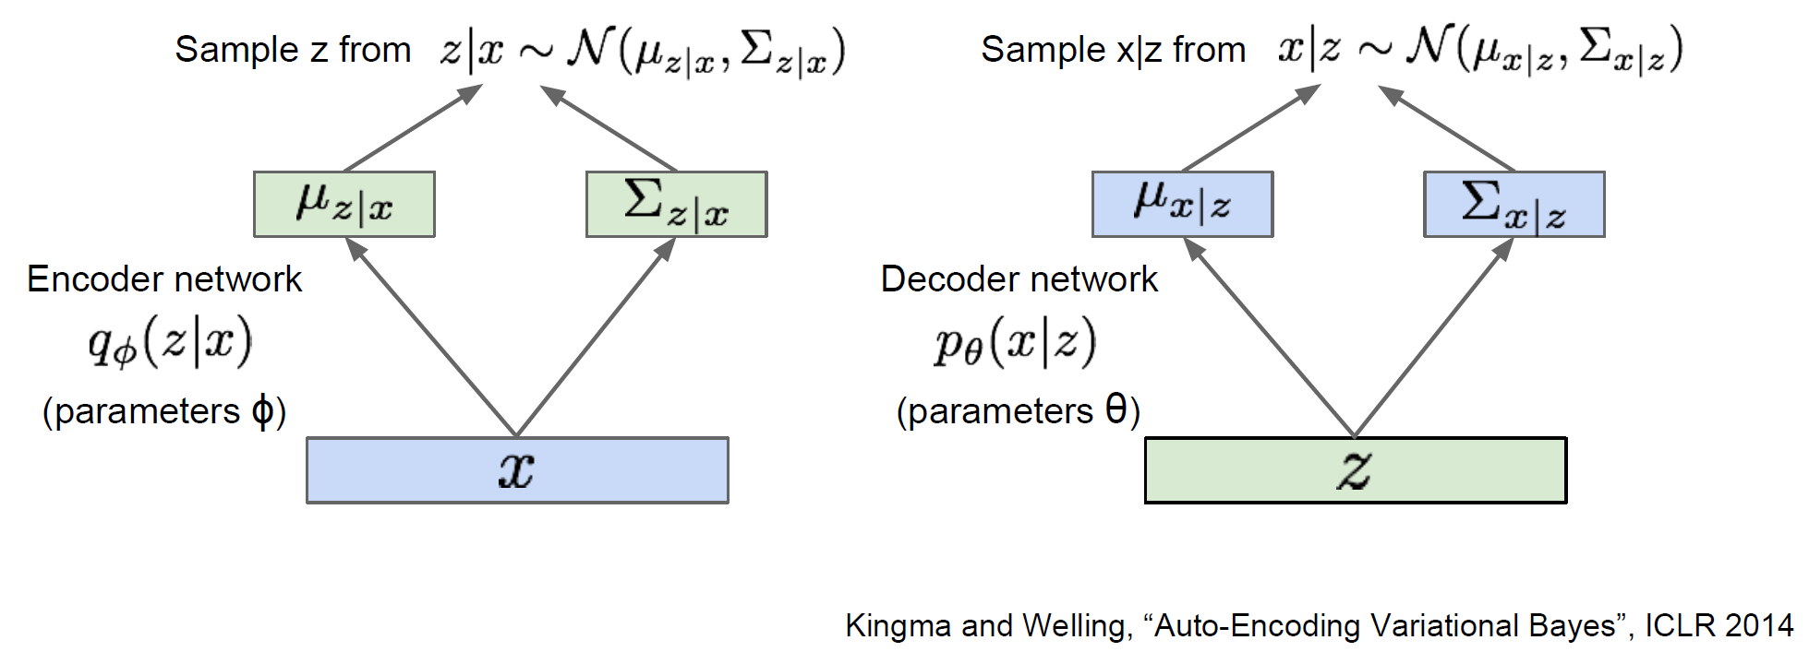
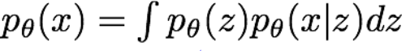
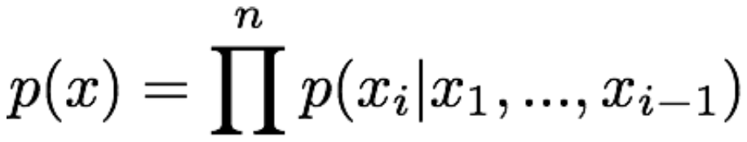
VAE and Pixel CNN
Modeling the data distribution p(x)
VAE:
Pixel RNN (CNN):

Slide 7
VQ-VAE
Posterior distribution p(z|x) is assumed normal distribution with diagonal covariance.
Modeling p(z|x) with Pixel CNN.

Slide 8
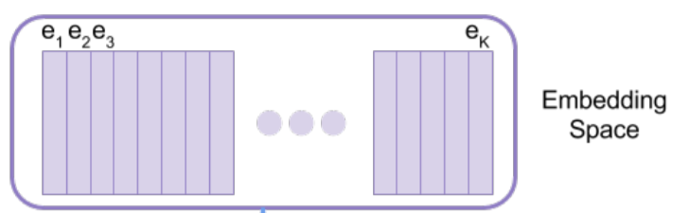
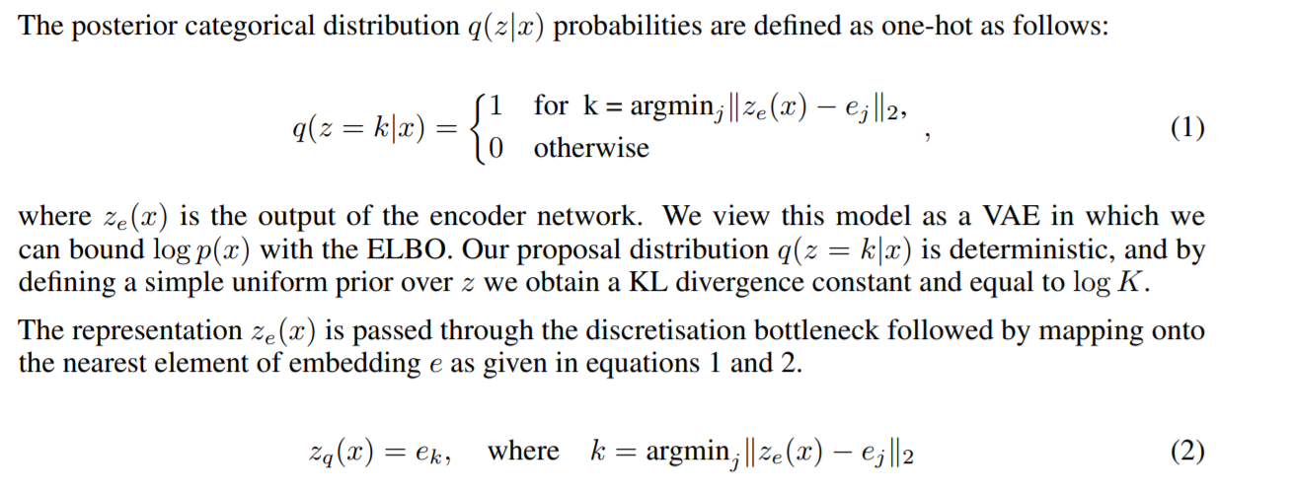
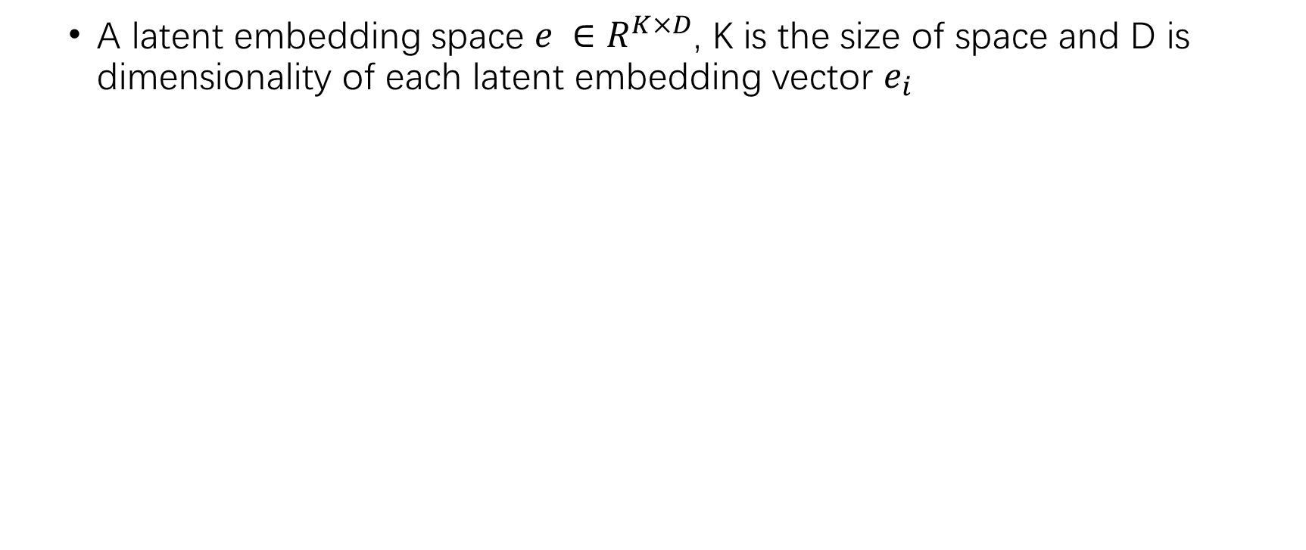
VQ (Vector Quantization)
A latent embedding space $e ∈R^{K×D}$, K is the size of space and D is dimensionality of each latent embedding vector $e_{i}$
[1] Neural Discrete Representation Learning, Aaron van den Oord, Oriol Vinyals, Koray Kavukcuoglu, NIPS 2017

Slide 9
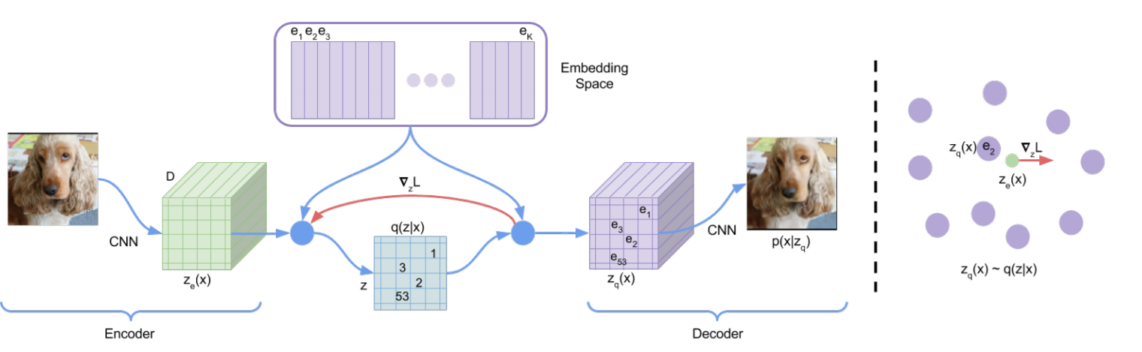
VQ-VAE Framework:
A latent embedding space $e ∈R^{K×D}$, K is the size of space and D is dimensionality of each latent embedding vector $e_{i}$
[1] Neural Discrete Representation Learning, Aaron van den Oord, Oriol Vinyals, Koray Kavukcuoglu, NIPS 2017

Slide 10
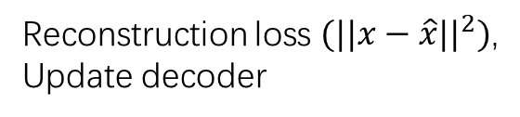
VQ-VAE Loss Function
Reconstruction loss $(||x−\hat{x}||^{2})$,
Update decoder
Update embedding space
Update encoder

Slide 11
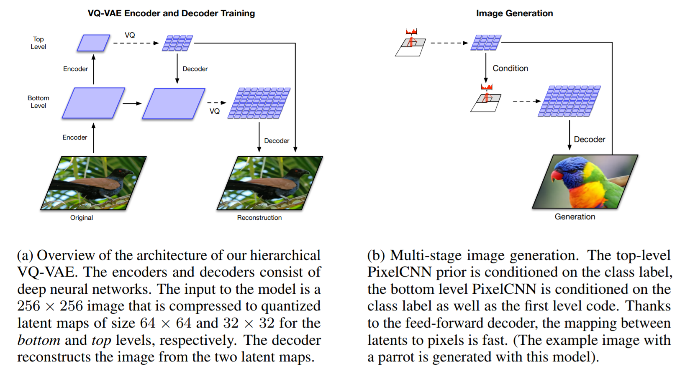
VQ-VAE(-2): Architecture
[2] Generating Diverse High-Fidelity Images with VQ-VAE-2, Ali Razavi∗, Aäron van den Oord∗, Oriol Vinyals, arxiv 1906.00446

Slide 12
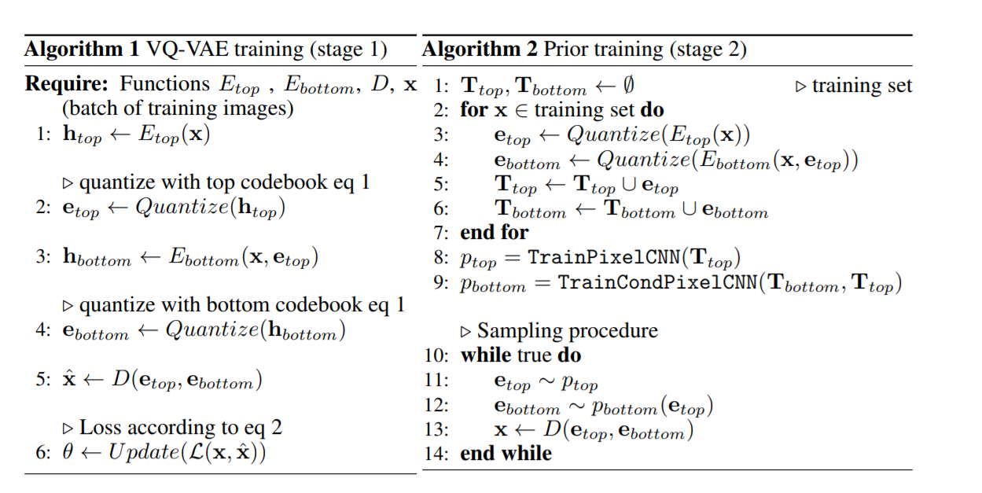
VQ-VAE(-2): Pipeline
[2] Generating Diverse High-Fidelity Images with VQ-VAE-2, Ali Razavi∗, Aäron van den Oord∗, Oriol Vinyals, arxiv 1906.00446

Slide 13
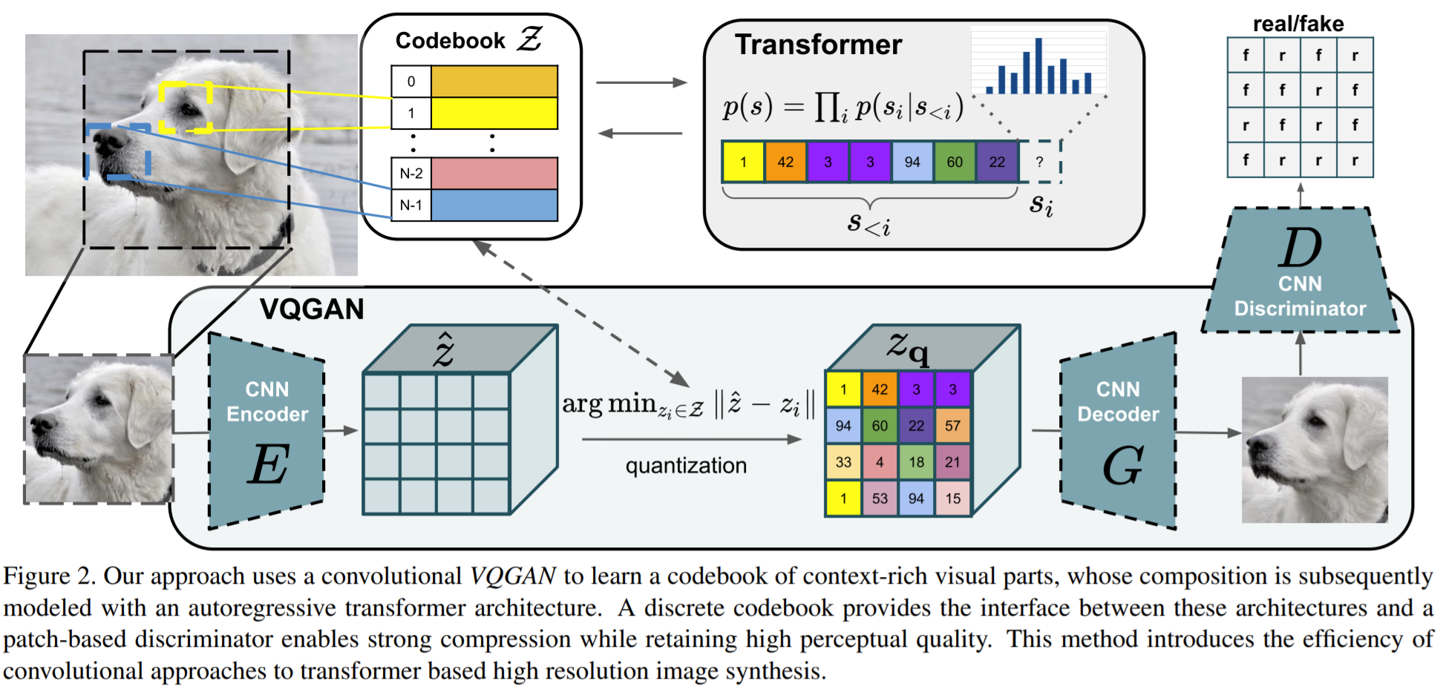
Transformer + VQ
http://xxx.itp.ac.cn/pdf/2012.09841.pdf

Slide 14
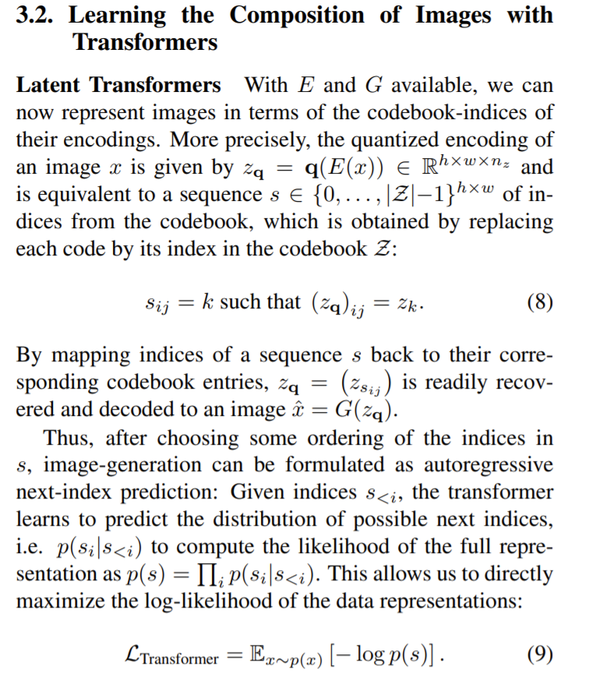
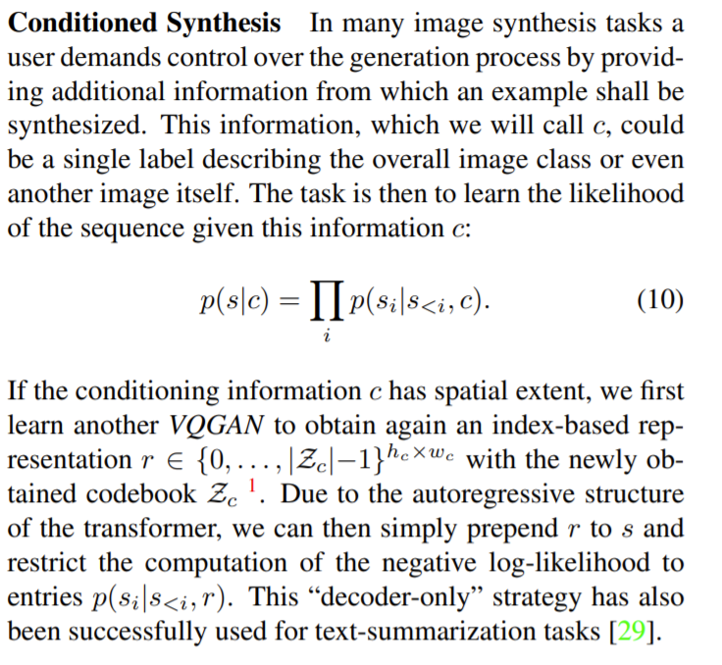
Transformer + VQ

Slide 15
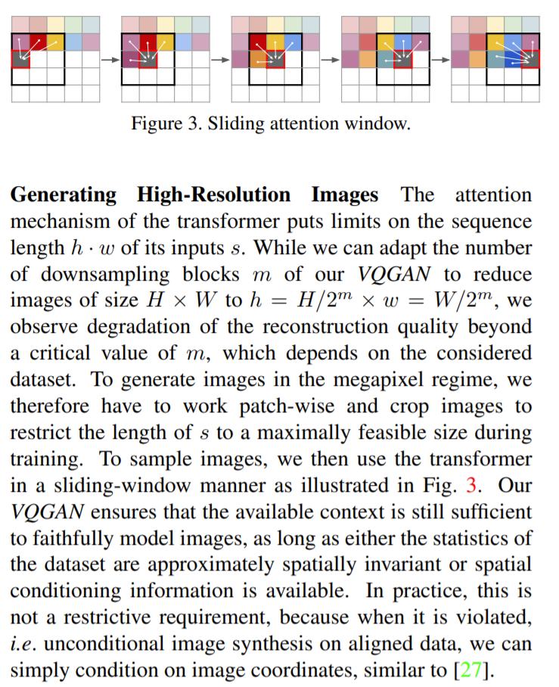
Transformer + VQ

